Slide 1
Processes and Threads in Windows
Telerik Software Academy
academy.telerik.com
Borislav Varadinov
Marian Marinov
System Administrator
CEO of 1H Ltd.
bobi@itp.bg
mm@1h.com

Slide 2


Table of Contents
Processes, Threads and Jobs
Access Tokens
Scheduling
Priority

Slide 3
Process, Thread and Jobs
What is a process?
Represents an instance of a running program
You create a process to run a program
Starting an application creates a process
What is a thread?
An execution context within a process
All threads in a process share the same per-process address space
What is a job?
Allows groups of process to be managed as a single unit

Slide 4
Process
A private 4GB virtual address space (8TB on 64-bit)
Processes cannot corrupt each other’s address space
An executable program, which defines initial code and data and is mapped into the process's virtual address space
A list of open handles to various system resources, such as files, registry objects and communication ports, that are accessible to all threads in the process
A security context called an access token that identifies the user, security groups, and privileges associated with the process
A unique identifier called a process ID
At least one thread of execution

Slide 5
Thread
The contents of a set of CPU registers representing the state of the processor
A private storage area called thread-local storage (TLS)
A unique identifier called a thread ID
Threads sometimes have their own security context that is often used by multithreaded server applications that impersonate the security context of the clients that they serve
The registers, the stacks, and the TLS are called the thread's context
Notes:
A unique identifier called a thread ID (also internally called a client ID—process IDs and thread IDs are generated out of the same namespace, so they never overlap)
Two stacks, one for the thread to use while executing in kernel mode and one for executing in user mode

Slide 6
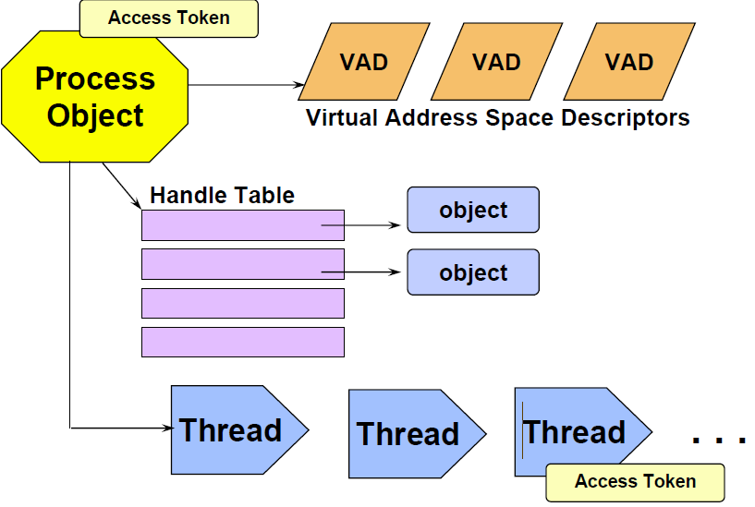
Processes and Threads
Notes:
For each process, the memory manager maintains a set of VADs that describes the status of the process’s address space. When a process reserves address space or maps a view of a section, the memory manager creates a VAD to store any information supplied by the allocation request, such as the range of addresses being reserved, whether the range will be shared or private, whether a child process can inherit the contents of the range, and the page protection applied to pages in the range.

Slide 7
What is an Access Token?
Access tokens contain the security information for a logon session
The system creates an access token when a user logs on.
Every process executed on behalf of the user has a copy of the token.
The token identifies the user, the user's groups, and the user's privileges.
The system uses the token to control access to securable objects.
There are two kinds of access token, primary and impersonation.

Slide 8
What is Impersonation?
Impersonation is the ability of a thread to execute using different security information than the process that owns the thread
Typically, a thread in a server application impersonates a client
This allows the server thread to act on behalf of that client to access objects on the server or validate access to the client's own objects

Slide 9



Thread Impersonation Example
Group/User | Type
Managers | R/W
Company Users | R
Administrators | F
SMB Server Process
Thread 1
Access Token
Bobi
Company Users
Administrators
F
Thread 2
Access Token
Secretary
Company Users
Office Assistants
File.docx
R
Thread 3
Access Token
Boss
Company Users
Managers
R/W

Slide 10
Multithreading Examples
Multiple threads are used when there are several tasks to be executed concurrently within a single logical context
Web Server supports many clients at the same time
Performing background work
Keeping the GUI responsive
Parallelizing a calculation across multiple processors

Slide 11

Thread Scheduling
Once every quantum, Windows looks at all ready threads (usually 20 or 30 milliseconds)
Only one thread is selected
Windows performs a switch to the context of this thread (a context switch)
Each thread has the illusion it’s the only piece of code running
Notes:
A quantum is the amount of time a thread gets to run

Slide 12
Windows Thread Scheduling Scheme
Windows scheduling
Priority-driven
Preemptive scheduling system
The highest-priority ready thread always runs
After the quantum expires, Windows may reschedule the thread
Windows may reschedule the thread even if its quantum has not expired
For example, if a higher-priority thread becomes ready to run

Slide 13
Scheduling Scenarios
When does the Windows scheduler schedule?
Voluntary switch by thread
Preemption
Quantum end
Thread termination

Slide 14
Scheduling On A Thread Basis
Scheduling decisions are made strictly on a thread basis
The process that a thread belongs to does not matter

Slide 15
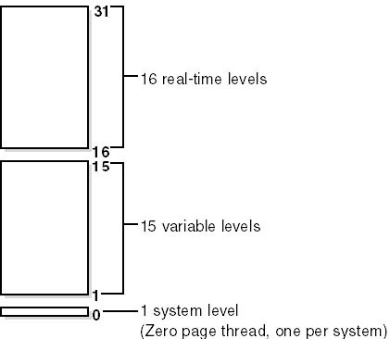
Thread Priority Levels
32 priority levels (0-31):
“Real-time” levels (16-31)
“Dynamic” levels (1-15)
System level (0), reserved for the zero page thread

Slide 16
Balance set manager
Once per second, the balance set manager looks for threads that haven’t run for longer time period
Boosts their priority to 15 and gives them double the normal quantum
Once the quantum is up, the execution is immediate
There’s a limit on the numbers of threads scanned and boosted at each pass

Slide 17
User mode threads
User mode threads allow an application to schedule its own “threads” of execution
Analogous to threading libraries under many Unix systems
A fiber is a unit of execution that must be manually scheduled by the application
User-mode scheduling (UMS) is a lightweight mechanism that applications can use to schedule their own threads. UMS threads differ from fibers in that each UMS thread has its own thread context instead of sharing the thread context of a single thread.
Notes:
. Fibers run in the context of the threads that schedule them. Fibers are invisible to the kernel because they are entirely implemented in user mode.
UMS is new technology introduced in Windows 7 (x64) and Windows Server 2008 R2. UMS threads have their own kernel thread state and are visible to the kernel.
A fiber is a unit of execution that must be manually scheduled by the application. Fibers run in the context of the threads that schedule them. Each thread can schedule multiple fibers. In general, fibers do not provide advantages over a well-designed multithreaded application. However, using fibers can make it easier to port applications that were designed to schedule their own threads.
Fibers are not preemptively scheduled. You schedule a fiber by switching to it from another fiber. The system still schedules threads to run. When a thread running fibers is preempted, its currently running fiber is preempted but remains selected. The selected fiber runs when its thread runs.

Slide 18
Windows Processes and Threads
http://academy.telerik.com

Slide 19




Free Trainings @ Telerik Academy
"Web Design with HTML 5, CSS 3 and JavaScript" course @ Telerik Academy
html5course.telerik.com
Telerik Software Academy
academy.telerik.com
Telerik Academy @ Facebook
facebook.com/TelerikAcademy
Telerik Software Academy Forums
forums.academy.telerik.com

